Slide 1

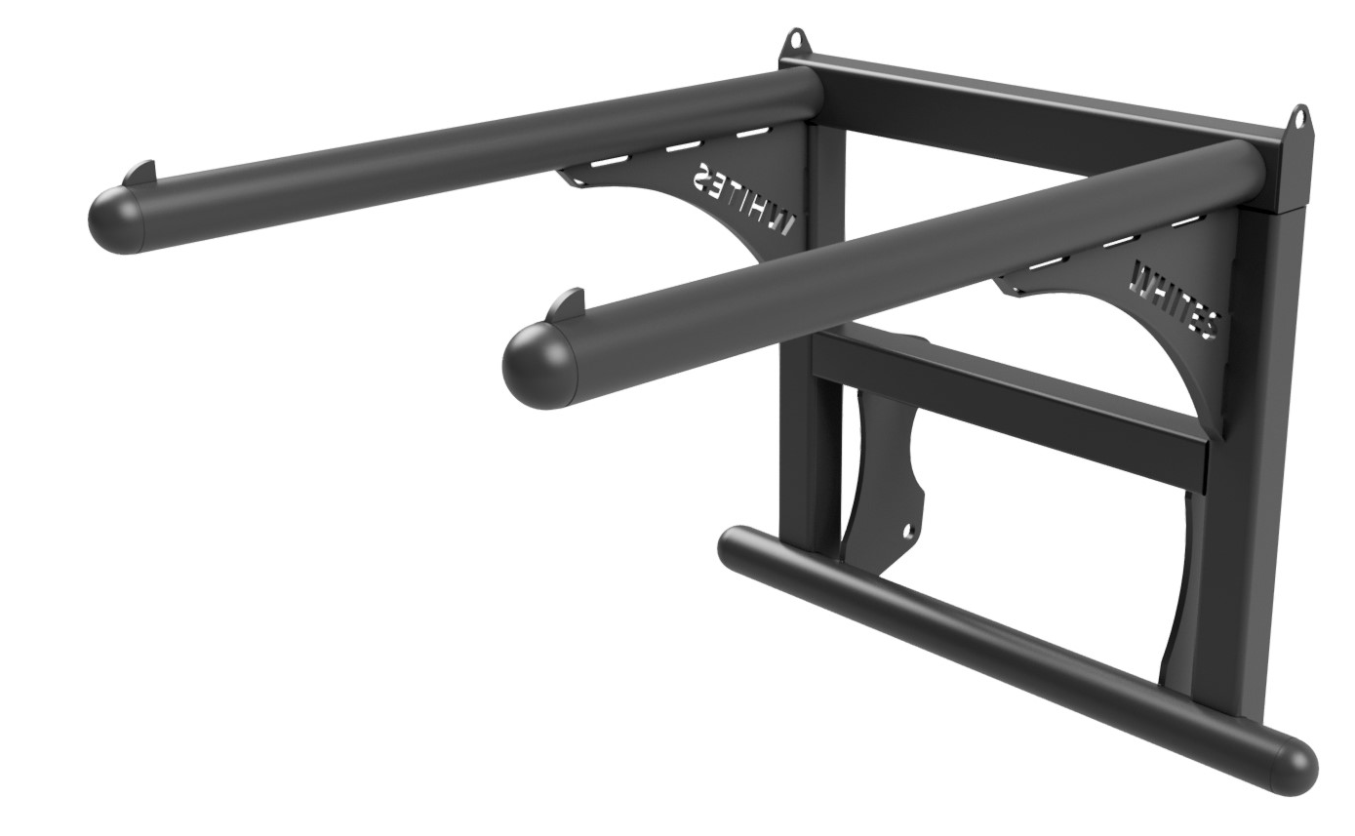
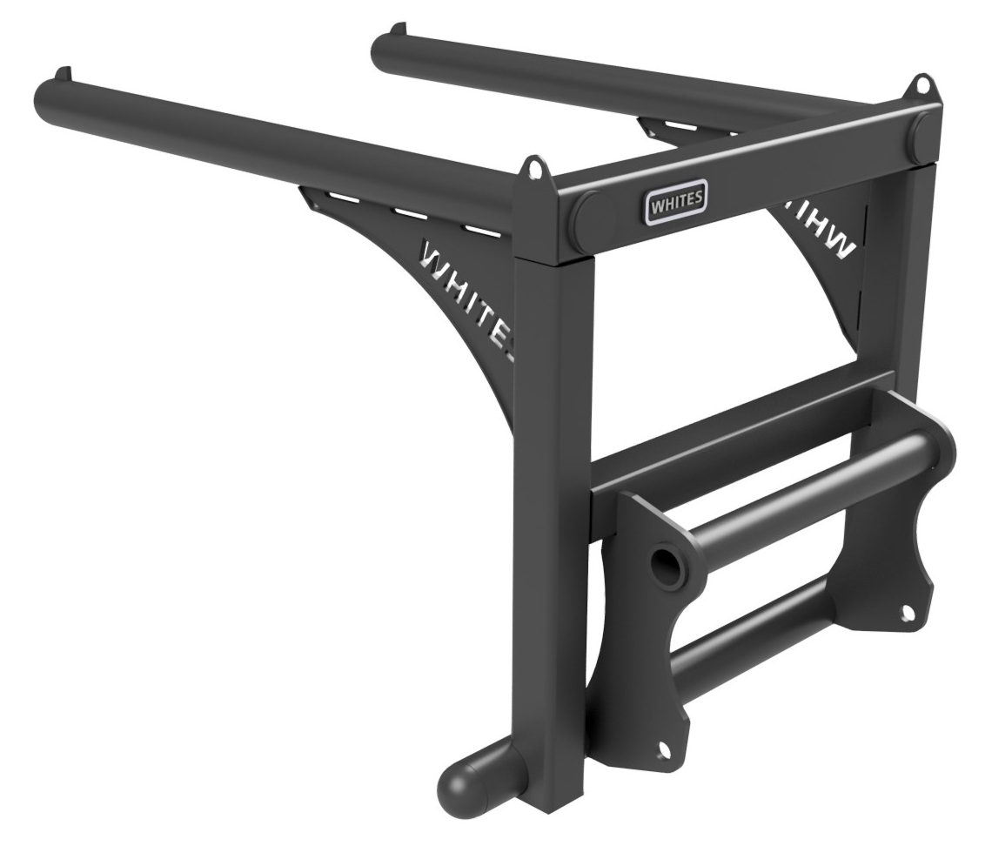





BAG LIFTERS
FEATURES
Suitable for 4 x 600kg fertiliser bags
1400mm long arms
950mm arm centres
Round tube arms
Arm spacing designed for quick, safe loading/unloading/stacking
Arm strops to help prevent bags slipping off
Anti-swing bar
Brackets included
WHITES MATERIAL HANDLING
17 - 19 EMERY ROAD
BRISTOL
BS4 5PF
0117 972 0006
WWW.WHITESMH.CO.UK
SALES@WHITESMH.CO.UK

